Slide 1
Function as a Service
Sprint 2

Slide 2
Content
Overview -- Lian
Current Work -- Zhuyu
Demo -- Yuhang, Yuxuan

Slide 3
Overview
System Design
Classes design - passenger & driver
Database
Functions Design
Passenger location update
Geohash
Openwhisk Deployment and Test
Geohash - redis deployment
User - Server Simulation
Paper Study
OpenLambda

Slide 4
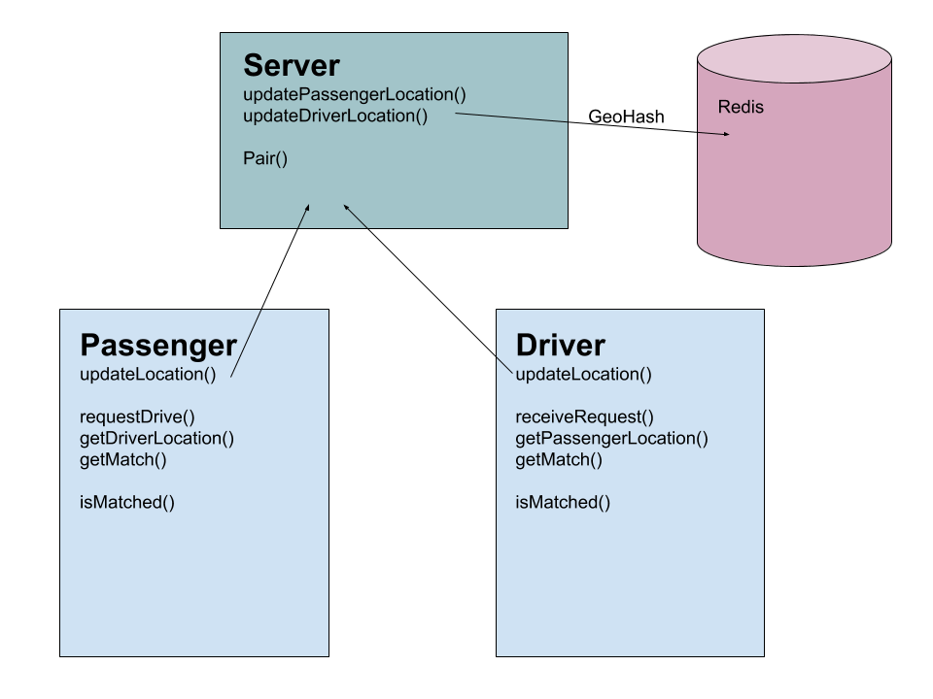

Slide 5
Current Work: Simulation
First function on OpenWhisk
Simulate the location synchronization
Simulate the area searching

Slide 6
Simulation: Users
Users (drivers & passengers) continuously send their locations to server
Every 2s in our simulation
User Info
ID: Ten alphanumeric values
First letter to identify user: ‘P’ for passenger, ‘D’ for driver
Location Info
Locations: (latitude, longitude)
[‘P123abc456’, -40, -40]

Slide 7
Simulation: Server
Calculate GeoHash Code for each location
Update corresponding user’s location at database
Clear obsolete data
In our simulation: Location hasn’t been updated over 20s
Searching qualified passengers for drivers
Basic implementation: return users in same geohash area (5km*5km)

Slide 8
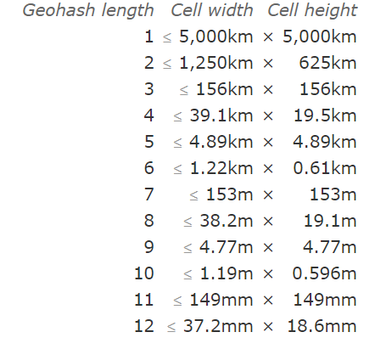
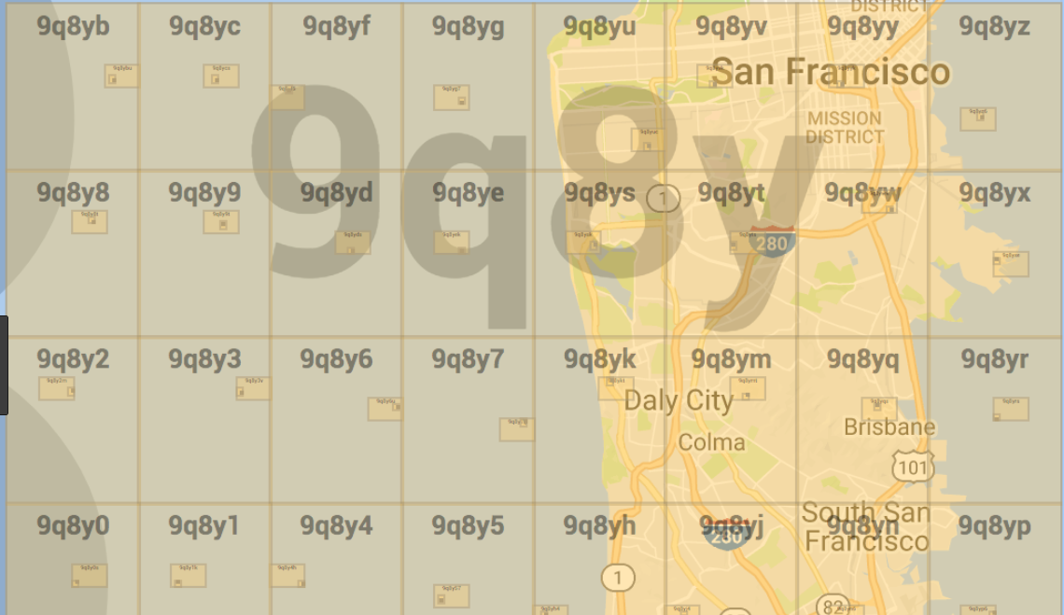
Simulation: GeoHash
Expressing a location using a short alphanumeric string
2D value to 1D value
A geohash identifies a rectangular cell
Longer geohash length means a smaller rectangular area
Use length 5 in our simulation: roughly 5km*5km area
Efficient in searching

Slide 9
Simulation: Database
3 Redis databases
DB0 stores locations of passengers
DB1 stores locations of drivers
DB2 stores users in different geocode areas
DB0: Passenger
Key Value: list
ID [la, lo, geohash]
DB1: Driver
Key Value: list
ID [la, lo, geohash]
DB2: GeoHash
Key Value:set
hash (id1, id2….)

Slide 10
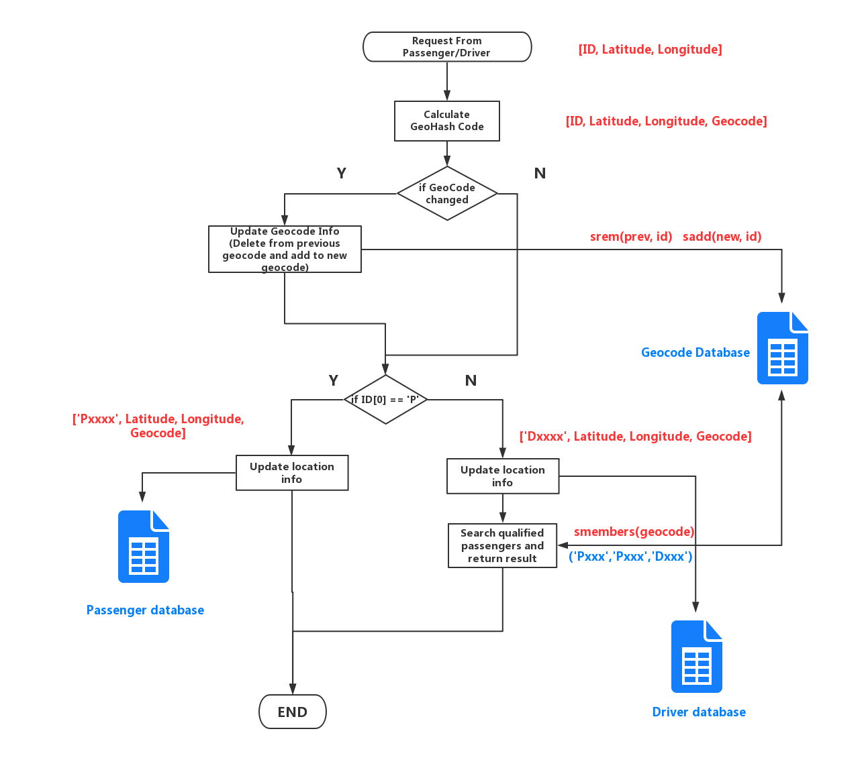
Simulation: Function Flow Chart
DB0: Passenger
Key Value: list
ID [la, lo, geohash]
DB1: Driver
Key Value: list
ID [la, lo, geohash]
DB2: GeoHash
Key Value:set
Hash (id1, id2….)

Slide 11
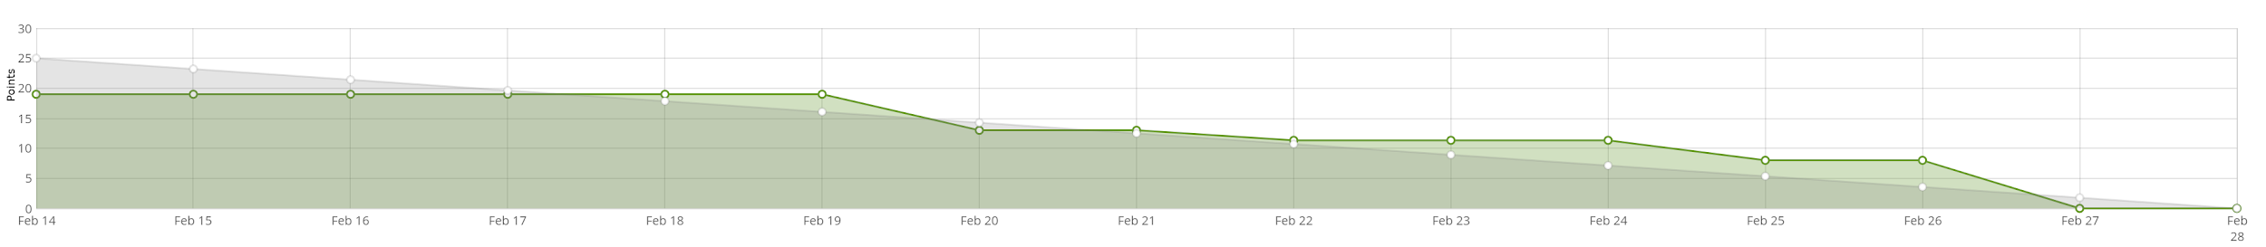
Current Sprint: Burn Down Chart

Slide 12
Demo
Total Area: 50km*50km
Search Scope: 5km*5km
Passenger Num:
Driver Num:
Timeout: 20s

